Slide 1

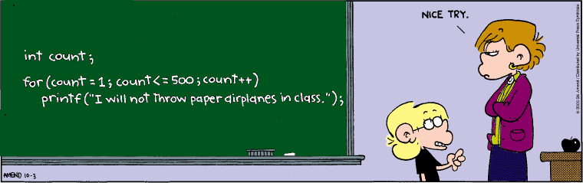
Programming
Programming concepts:
Boolean Expressions, Conditionals & Loops

Slide 2
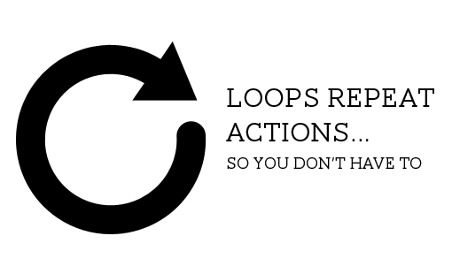
Learning Objectives
Repetition of commands
Boolean test (expression) – true/false
For Loop – determinate Loop
Repeats a set of commands a specific number of times
Pseudocode – problem step written in English
Help to design/write code
Solve problems
While loop – Indeterminate Loop
Repeats while a test is true
We’ll use while
later in the course

Slide 3
Revision : Boolean expressions
Expression which is : True or False
Used to test something, e.g. compare two values, x == 50
Syntax
Can be combined with Boolean AND, OR, NOT etc
Meaning
Examples
a == b | Value in a equal to value in b | if (x == 20) if (x1 == x2)
a < b | Value in a smaller than b | if (x < 0) if (x1 < x2)
a > b | Value in a greater than b | if (y > height) if (y1 > y2)
a <= b | a smaller than or equal to b | if (y<=0)
a >= b | a greater than or equal to b
a != b | a not equal to b
&& | AND
|| | OR
! | NOT
Notes:
Variable a contains a value equal to the value in variable b, etc

Slide 4
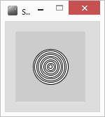
For Loop : Example
Want to draw concentric circles
int size=50;
for(int i=0; i<10; i++)
{
ellipse(50,50, size,size);
size=size-5;
}
Note : for loop uses braces { }, not a “;”
commands inside are repeated

Slide 5
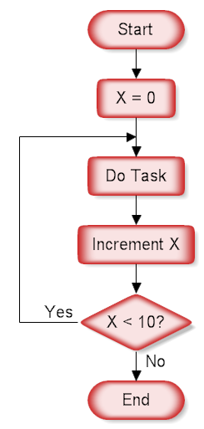
For Loop : syntax
for( int i=0 ; i<10 ; i++ )
Always use a variable – typically a counter i
For – 3 parts, divided by ‘;’
int i = 0 variable starting value(s)
i is a counter with an initial value of 0
i<10 end condition – keep going while true
If value in i is less than 10 keep going
i++ Do this each time around the loop
Add 1 to value in i (increment)
could also be written i=i+1

Slide 6
Example 1st Loop
i=i+1
size=size-5
drawing concentric circles
(paste code, run in debug)
int size=50;
for(int i=0; i<10; i++)
{
ellipse(50,50,size,size);
size=size-5;
}
0
50
1
45
i
size
Notes:
A

Slide 7
Example 2nd Loop
i=i+1
size=size-5
drawing concentric circles
int size=50;
for(int i=0; i<10; i++)
{
ellipse(50,50,size,size);
size=size-5;
}
2
1
45
40
i
size

Slide 8
Example 3rd Loop
i=i+1
size=size-5
drawing concentric circles
int size=50;
for(int i=0; i<10; i++)
{
ellipse(50,50,size,size);
size=size-5;
}
3
2
40
35
i
size

Slide 9
Example 10th Loop
i=i+1
size=size-5
drawing concentric circles
int size=50;
for(int i=0; i<10; i++)
{
ellipse(50,50,size,size);
size=size-5;
}
//finished loop
10
9
5
0
i
size
i is 10, loop complete

Slide 10
While vs For
Use For loop when you know how many times you want to perform a task
Use while loop when you don’t know how many repetitions
While something is true (or is not true ‘!=‘)
Example want to draw crosses all across the screen (width is 100)
while (crossX < 100)
{
//draw cross at crossX
// move right a bit
}

Slide 11
Lab Sheet Exercise 1
size(200, 200);
line(20, 0, 20, height);
line(40, 0, 40, height);
line(60, 0, 60, height);
line(80, 0, 80, height);
line(100, 0, 100, height);
line(120, 0, 120, height);
line(140, 0, 140, height);
line(160, 0, 160, height);
line(180, 0, 180, height);

Slide 12
Examples : try these
e.g.1
for(int i=0; i<10; i++)
{
println(i);
}
e.g. 2
for(int i=100; i>0; i=i-10)
{
println(i);
}
e.g. 3
int x = 10;
size(300,100);
fill(0);
for(int i=100; i>0; i=i-10)
{
text(""+i,x,20);
x=x+25;
}
Once finished :
attempt exercise 2, A to D

Slide 13
Another example
int size;
for(size=50; size>0; size=size-5)
{
ellipse(50,50,size,size);
}
What would this do?
Same result,
size is our counter- start value is 50
keep going while size bigger than 0
Each time take 5 away from size

Slide 14
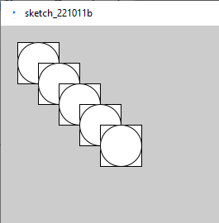
Pair Programming Task
Design?
Code

Slide 15
For Loops – how many loops?
for(int i=1;i<=5;i++) //smaller than or equal to
{
//do task
}
for(int x=10;x<50;x=x+10)
{
//do task
}
for(int c=10;c>5;c--)
{
//do task
}
Notes:
How could we find out? Add a print line

Slide 16
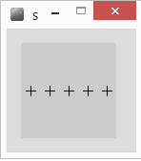
Draw 5 crosses
float x=10;
float y=50;
line(x-5,y,x+5,y);
line(x,y-5,x,y+5);
Draws a cross
centre at x,y
float x=10;
float y=50;
for(int i=0;i<5;i++)
{
line(x-5,y,x+5,y); // Draw cross
line(x,y-5,x,y+5);
x=x+20; //move right a bit
}
PseudoCode - English
For 5 repetitions
{
Draw a cross
Move right a bit
}

Slide 17
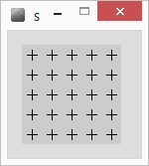
Nested For Loop
You can put one loop inside another
Here I want to draw 5 lines of crosses
Increasing y after each line
A for loop
Each line of crosses consists of 5 crosses
Another for loop
For 5 repetitions
{
For 5 repetitions
{
Draw a cross
Move right a bit
}
Move down a bit
}
PseudoCode - English
For 5 repetitions
{
Draw a line of crosses
Move down a bit
}

Slide 18
Nested For Loop 2
For 5 repetitions
{
For 5 repetitions
{
Draw a cross
Move right a bit
}
Move down a bit
}
float x=10;
float y=10;
for (int i=0;i<5;i++)
{
for(int j=0;j<5;j++)
{
line(x-5,y,x+5,y); //draw cross
line(x,y-5,x,y+5);
x=x+20; //move right a bit
}
x=10; //set x back to far left
y=y+20; //move down a bit
}
Must be different
counter variables

Slide 19
Tracing Nested For Loops
float x=10;
float y=10;
for (int i=0;i<5;i++)
{
for(int j=0;j<5;j++)
{
line(x-5,y,x+5,y); //draw cross
line(x,y-5,x,y+5);
x=x+20; //move right a bit
}
x=10; //set x back to far left
y=y+20; //move down a bit
}
0
i
3
1
4
2
3
1
4
2
0
j

Slide 20
Tracing Nested For Loops
float x=10;
float y=10;
for (int i=0;i<5;i++)
{
for(int j=0;j<5;j++)
{
line(x-5,y,x+5,y); //draw cross
line(x,y-5,x,y+5);
x=x+20; //move right a bit
}
x=10; //set x back to far left
y=y+20; //move down a bit
}
1
i
3
1
4
2
3
1
4
2
0
j

Slide 21
Tidy up - Refactor
Refactor – tidy up the code
Use x and y as counters within for loops
for (int y=10; y<100; y=y+20)
{
for(int x=10; x<100; x=x+20)
{
line(x-5, y, x+5, y); //draw cross
line(x,y-5,x,y+5);
}
}
same result, fewer variables,
easier to understand the code

Slide 22
For Loop : Run time errors
Infinite loop – goes forever
Why?
for(int i=0; i>=0; i++)
i is ALWAYS 0 or greater
for(int i=0; i != 10; i=i+3) //i not equal to 10
i NEVER contains a 10
for(int i=0; i < 10; i++);
{ point( x+(i*10), 50); }
how many points?

Slide 23
Lab Exercises
Exercise 3, B & C

Slide 24
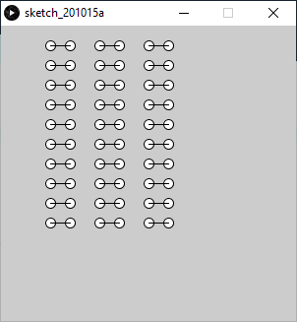
How?
Design (together)
Draw a dumbbell, 2 ellipses and a line from each centre
Draw a column,
Draw 3 columns
Code your solution (Exercise 3)

Slide 25
Exercises
Exercise 4 – all parts

Slide 26
Summary
Boolean expressions : TRUE, FALSE
AND - &&
OR - ||
NOT - !
Conditionals : if( ) else if( ) else if( ) else
While loop : repeat code block while expression is true
For loop : repeat code block a specific number of times

